Slide 1
Cortical Plasticity
Student’s Name
Student’s Number
Section Number
Professor’s Name

Slide 2
Introduction
Generation of thoughts and ideas
Role of the brain in human movement
Reaction to certain things
Centrality of the human brain
Controlling of certain human characteristics
Notes:
What generates thoughts and ideas? How are we humans able to move our feet from one point to another? Why do we cry when we receive bad news? All these dynamic activities that form the broader scope of day to day activities are not haphazard but are controlled from within, and the organ responsible is the human brain.

Slide 3
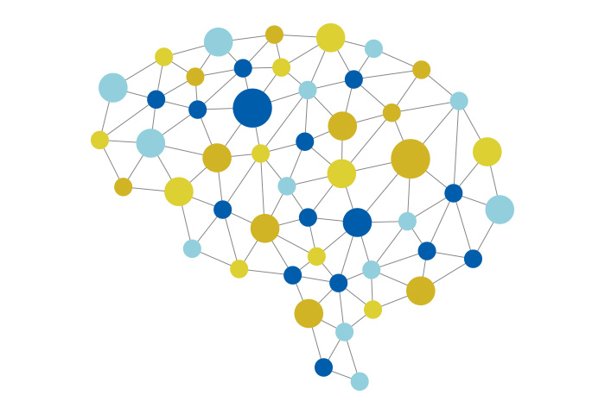
The Human Brain
Complex large system
Impulsivity
Chemicals and electric signals
Cerebrum, cerebellum, brain stem, and diencephalon
Body functions
Image: Neural plasticity
Notes:
The human brain is the part of a larger complex system called the nervous system that is driven impulsively by chemicals and electric signals (Morris, 2016). Made up of four major regions; the cerebrum, cerebellum, brain stem, and diencephalon, the human brain is responsible for coordinating all the body functions.

Slide 4
Information Processing
Neural communication
Change through experiences
Functionality of human beings
Processing units
Distinctive factor
Notes:
Information is processed in the brain and then relayed to the rest of the body parts by neurons, which are essentially the processing units, and this brings rise to the functionality of human beings. Essentially, it is the brain that acts as the operating system for human beings and distinguishes us from other organisms.
The nerve cells changes as new experiences emerge throughout the life of a person.

Slide 5
Functions of the Brain in Human Behavior
Behavioral traits
Composition of the human body
Seamless functioning of the body
Response to stimuli
Learning and memory framework
Notes:
Functioning and behavior of humans are pivotal and dependent on the human brain. The human body comprises of many organs, and the human brain assumes the primary role to ensure that all these organs function seamlessly. Human beings respond to stimuli that would not be possible without the human brain for learning and memory (Chandy, 1967) and this would be seen as one of the main functions of the brain.

Slide 6
Higher Human Functions
Cognitive and intellectual abilities
Learning and reasoning
Coordination of muscle movements
Cerebellum functions
Balance and posture functions
Notes:
Cognitive abilities and intelligence, which distinguish human beings from other creatures, are all possible due to responsiveness and the functionality of the brain. The cerebrum is responsible for higher human functions such as learning and reasoning. Co-ordination of muscle movements which is vital for maintaining body balance and posture are functions of the cerebellum. Learning and reasoning develops a neural system intelligence that helped Jodi remember how to walk.

Slide 7
Diencephalon
Auditory and visual senses
Release of hormones
Instinctual and sensations
Brain malfunctions
Core engine
Notes:
Auditory and visual senses are managed in the brainstem while the diencephalon is in charge of regulating the release of hormones for sensations and instinctual behavior. Jodi will be able to apply these sensations and instincts to gain certain abilities he had lost. When the brain malfunctions, other problems such as epilepsy and Alzheimer’s arise (Morris, 2016). It is the human brain therefore that is the core engine of all human activities and operations.

Slide 8
Brain Lateralization
Functionality of the cerebrum
The right and the left hemisphere
Longitudinal fissure
Corpus collasum via communication
Functionality of all tissues
Notes:
The cerebrum is the part of the brain that is subject to lateralization. Brain lateralization is the concept whereby the brain is divided into two hemispheres, the right, and the left hemisphere. The two hemispheres are divided by a longitudinal fissure but they still maintain communication via the corpus callosum which ensures the functionality of all tissues of the human body (Chandy, 1967).

Slide 9
Left Hemisphere
Physical identity
Differential functionality
Left hemisphere
Broca’s and Wernicke’s regions
Understanding and communicating
Logic
Notes:
Although the hemispheres are physically identical, they differ in functionality. If a person were to lose the left hemisphere of the brain, they wouldn’t have the ability to understand and communicate as language formation is a dominant function of Broca’s and Wernicke’s regions that are located in the left hemisphere. Logic is also greatly influenced by the left hemisphere. Jodi’s cognitive, communication, and logical abilities were likely to be impacted negatively.

Slide 10
Right Hemisphere
Interpretation and emotional tone of language
Creativity
Hemispherectomy surgery
Dr. Ben Carson case study
Notes:
The right hemisphere of the brain is responsible for interpreting the emotional tone of language and also influences creativity. When a hemispherectomy surgery, which involved removing one hemisphere of the brain, was performed by pediatric neurosurgeon Dr. Ben Carson on a three-year-old girl the concept of lateralization was demonstrated. On removal of the right hemisphere of her brain, the girl’s left hemisphere had to undergo a process called plasticity for her to gain back abilities of some activities such as walking. Brain lateralization is therefore key in the functionality of human beings due to the distribution of abilities on either hemisphere. The phenomenon could have impacted Jodi’s creativity and linguistic emotions.

Slide 11
The Phenomenon of Cortical Plasticity.
Loss of one hemisphere
Self-modification
Occurs after sustaining injuries
Crucial to Jodi’s situation
Recovery process
Notes:
Realizing that the brain is divided into two hemispheres arouses the urge to ask, what then happens when one hemisphere is lost? Cortical Plasticity. The brain basically can adjust to change through self-modification (Pitts-Taylor, 2010). This process of that can be termed as rewiring of the brain often takes place after injuries. The concept applies to Jodi’s recovery situation.

Slide 12
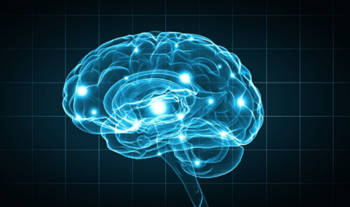
Short-term and Lon-term Neuroplasticity
Chemical Changes
Structural changes
Formation of new neurons
Density and the length of dendrites
Image: Neural brain functionality
Notes:
Short term neuroplasticity only requires chemical changes on the neurons whereas long term changes require a structural change where new neurons are formed. Loss of a hemisphere requires structural changes that affect the density and length of dendrites (Pitts-Taylor, 2010) which is a step towards achieving lost abilities.

Slide 13
Recovery Process
Time is a factor in recovery
Adverse health conditions
Stroke and heart attacks
Regaining of certain ability
Brains ability to adapt to plasticity
Notes:
This explains why with time and the aid of therapy, patients who have experienced conditions such as stroke and lost some of the abilities start regaining them. What seems miraculous is a result of the brain’s ability to adapt through plasticity.

Slide 14
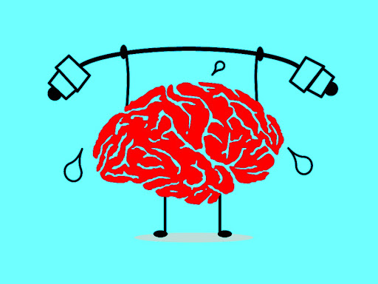
Adaptive measure
Cortical plasticity is an adaptive measure
Compromised normal functioning
Normal functioning
Apex of functionality
Jodi will recover based on the phenomenon
Image: Adaptive brain
Notes:
Plasticity, therefore, is an adaptive measure to ensure that the human body can function even when the human brain is compromised. Conclusively, according to studies, it can be argued that the human brain is the apex of human functionality. Jodi will be able to recover after the surgery due to the tendency of the brain to adapt to changes after injuries.

Slide 15
Summary
The brain is a vital
Coordination of human functions
Speech to movement
Broader creation
Cognitive abilities and intelligence
Notes:
I have learned that human brain plays a vital role in coordinating the body from speech to movement to all the sensory responses of human beings. I have also learned that human beings are part of the broader creation but the cognitive abilities and intelligence are what sets the distinction between human beings and other organisms.

Slide 16
Conclusion
Manifestation of the human
Adaptive abilities
Regenerative capabilities
Essence of cortical plasticity
Retention of abilities after injuries
Notes:
. The human brain itself also manifests its power by being able to adapt and regenerate when damage is caused to it. Cortical plasticity is important in ensuring that human beings can retain their abilities, therefore giving individuals the chance to continue boasting of productivity.

Slide 17
References
Chandy, J. (1967). THE HUMAN BRAIN. Current Science, 36(2), 29-32. Retrieved from www.jstor.org/stable/24062546
Morris, A. (2016). The Brain. In Why Icebergs Float: Exploring Science in Everyday Life (pp. 72-85). London: UCL Press. Retrieved June 9, 2020, from www.jstor.org/stable/j.ctt1gxxpgr.13
Pitts-Taylor, V. (2010). The plastic brain: Neoliberalism and the neuronal self. Health, 14(6), 635-652. Retrieved from www.jstor.org/stable/26650062

Slide 18
Graphics
Adaptive brain
Neural brain functionality
Neural plasticity

